Slide 1
Chapter 1 Basic Concept
Notes:
第一章 基本概念

Slide 2
1.1 Overview
Data structure + Algorithm = Programming
The tools and techniques to design and implement large-scale computer systems:
  Data abstraction
  Algorithm specification
  Performance analysis
  Performance measurement
Notes:
数据结构+算法=程序
研发大型计算机系统中的工具和技术：
数据抽象
算法实现
性能分析
性能度量

Slide 3
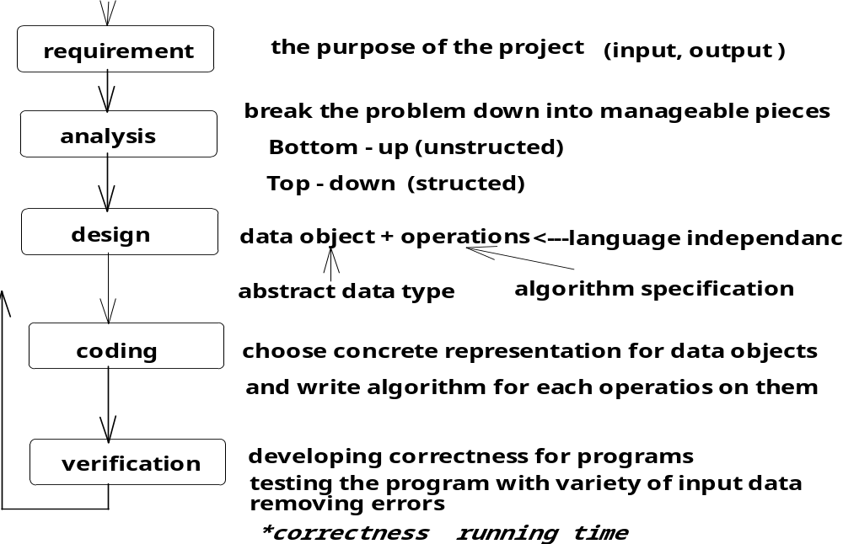
System life cycle
The system development process
Notes:
系统生命周期
需求→分析→设计→编码→验证

Slide 4
Basic Concept of data structure
数据：
是信息的载体，是描述客观事物的数、字符以及所有能输入计算机中并被计算机程序识别和处理的符号的集合。
数据的分类：
  数值性数据
  非数值性数据
数据对象：
将数据按其性质归类到一起，称为数据对象（data object),是数据的子集。
数据元素：
数据对象中的数据成员称为数据元素，它们具有相同的性质，是数据的基本单位。 （例如：结点、顶点、记录等）

Slide 5
Data structure
Data Structure = {D,R}
  数据结构由某一数据对象及该对象中所有数据成员之间的关系组成。
  D为某一数据对象
  R是该对象中所有数据成员之间的关系的有限集合
定义1
  数据元素之间的相互关系称为结构，带有结构的数据元素的集合称为数据结构。
定义2
  按某种逻辑关系组织起来的一批数据（或称带结构的数据元素的集合）应用计算机语言并按一定的存储表示 方式把它们存储在计算机的存储器中，并在其上定义了一个运算的集合。

Slide 6
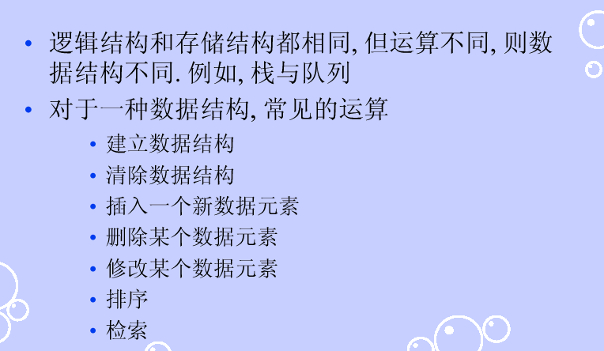
数据结构关心的三方面内容
逻辑结构
  数据元素间抽象化的相互关系（简称为数据结构）。
  与数据的存储无关，独立于计算机，它是从具体问题抽象出来的数学模型。
存储结构（物理结构）
  数据元素及其关系在计算机存储器中的存储方式。
  是逻辑结构用计算机语言的实现
  它依赖于计算机语言。
算法

Slide 7

逻辑结构 - 1
线性结构 Linear structure
  仅有一个开始元素，仅有一个最后元素；其余都是内部元素，且都有且仅有一个直接前驱和一个直接后继。
  线性表B={K，R}
    K={K₀，K₁，…，K_{n-1}}
    R={r}，r={<k_{i-1},k_{i}>|k_{i}∈K,1<i<n}
  线性结构的元素存取方式
    直接存取结构：不用访问元素前驱和后继即可访问该元素，如数组。
    顺序存取结构：只能从表的第一个元素按顺序访问，如链表。
    词典结构（广义索引）：字典与数组有相同之处，数组通过下标访问，字典通过关键码（key)进行索引访问。

Slide 8
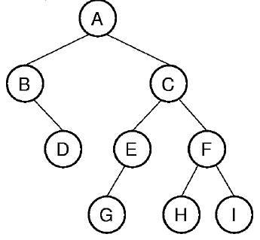
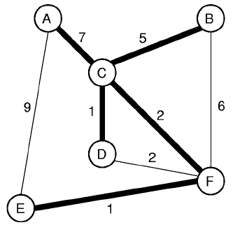
逻辑结构 - 2
非线性结构 Nonlinear structure
  各个数据成员不再保持在一个线性序列中。
  每个数据成员可能与零个或多个其他数据成员发生联系。可分为层次结构和群结构。
  层次结构
    按层次划分的数据元素的集合，指定层次上的元素，可以有零个或多个处于下一层次上的，直接的所属元素。例如：树结构（树、二叉树、堆）
  群结构
    所有元素之间无顺序关系。例：集合就是一种群结构。图结构也属于群结构。

Slide 9

存储结构
存储结构两方面的内容
  数据元素自身值的表示（数据域）
  该结点与其它结点关系的域（链域）
四种基本的存储结构
  顺序存储方法（结构）
  sequential access
  链接存储方法（链式存储结构）
  Linked access
  索引存储方法
  Indexing access
  散列存储方法
同一种逻辑结构可采用不同的存储方法（以上四种之一或组合），这主要考虑的是运算方便及算法的时空要求。

Slide 10
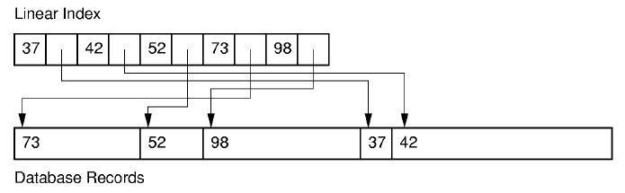
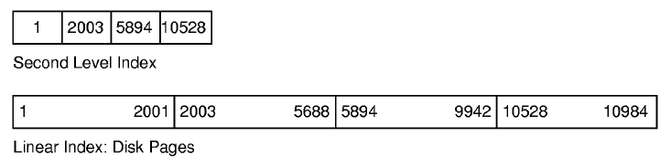
索引存储

Slide 11
1.2 Pointers and Dynamic Memory Allocation
Pointers
  Symbols
  Good Habits
Dynamic Memory Allocation
  位置
  申请和释放
  类型转换

Slide 12
1.3 Algorithm Specification
【Definition】 An algorithm is a finite set of instructions that, if followed, accomplishes a particular task, In addition, all algorithms must satisfy the following criteria:
  (1) Input. There are zero or more quantities that are externally applied.
  (2) Output. At least one quantity is produced.
  (3) Definiteness. Each instruction is clear and unambiguous.
  (4) Finiteness. If we trace out the instructions of an algorithm. then for all cases, the algorithm terminates after finite number of steps.
  (5) Effectiveness. Every instruction must be basic enough to be carried out, in principle, by a person using only pencil and paper, It is not enough that each operation be definite as in (3); it also must be feasible.
The distinguishes between an algorithm and a program:
Program----- does not have to satisfy(4) (operation system)
a programming language
Algorithm---- may be natural language, graphic, or a programming language
Notes:
算法的概念：一组有限的指令序列，能够完成特定的任务，并且要满足以下条件：
输入、输出、确定性，有穷性，有效性
程序和算法的区别：程序可以不满足有穷性，但必须用特定的程序语言，算法必须满足所有条件，但是可以使用自然语言、图标或者程序语言描述

Slide 13
Sorting
Rearrange a[0], a[1], …, a[n-1] into ascending order. When done, a[0] <= a[1] <= … <= a[n-1]
8, 6, 9, 4, 3 => 3, 4, 6, 8, 9
Notes:
排序操作
Strictly speaking, nondecreasing order: 2, 2, 3, 6, 8, 8, 10.
严格的说，非降序排列

Slide 14
Insert An Element
Given a sorted list/sequence, insert a new element
Given 3, 6, 9, 14
Insert 5
Result 3, 5, 6, 9, 14
Notes:
插入排序法

Slide 15
Insert an Element
3, 6, 9, 14 insert 5
Compare new element (5) and last one (14)
Shift 14 right to get 3, 6, 9, , 14
Shift 9 right to get 3, 6, , 9, 14
Shift 6 right to get 3, , 6, 9, 14
Insert 5 to get 3, 5, 6, 9, 14

Slide 16
Insert An Element
/* insert t into a[0:i-1] */
int j;
for (j = i - 1; j >= 0 && t < a[j]; j--)
a[j + 1] = a[j];
a[j + 1] = t;
Notes:
Note that this code is different from that given in Chapter 7. First, we sort a[0:n-1] here whereas we sort a[1:n] in Chapter 7. Also, we use a for loop here whereas we use a while loop in Chapter 7.

Slide 17
Insertion Sort
Start with a sequence of size 1
Repeatedly insert remaining elements

Slide 18
Insertion Sort
Sort 7, 3, 5, 6, 1
Start with 7 and insert 3 => 3, 7
Insert 5 => 3, 5, 7
Insert 6 => 3, 5, 6, 7
Insert 1 => 1, 3, 5, 6, 7

Slide 19
Insertion Sort
for (i = 1; i < n; i++)
{/* insert a[i] into a[0:i-1] */
/* code to insert comes here */
}

Slide 20
Insertion Sort
for (i = 1; i < n; i++)
{/* insert a[i] into a[0:i-1] */
int t = a[i];
int j;
for (j = i - 1; j >= 0 && t < a[j]; j--)
a[j + 1] = a[j];
a[j + 1] = t;
}
Notes:
0914

Slide 21
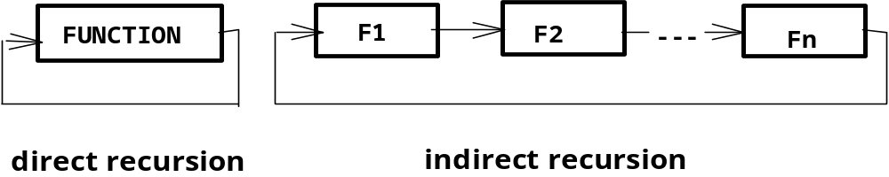
Recursive algorithm
【Definition】 function that is defined in terms of itself is called recursive.
FACTORIAL
n! = n·(n-1)! n>1 ( 0! = 1)
n! = n·(n-1)·(n-2) … 3·2·1
MULTIPLY
a·b = a·(b-1) + a (a·1 = a)
a·b = a·(b-1) + a = a·(b-2) +a +a = a·(b-3) + a + a +a …
= a + a + … + a + a (b times addition)
FIBONACCI NUMBER
fib (n) = n n=0 or n=1
fib (n) = fib(n-2) + fib(n-1) otherwise
Notes:
递归算法：
函数直接或者间接调用自身

Slide 22
Two fundamental rules of recursion
１.Base cases. You must always have some base cases, which can be solved without recursion.
２.Making progress. For the cases that are to be solved recursively, the recursive call must always be to a case that makes progress toward a base case.
#include <stdio.h>
int
F( int X )
{
/*1*/ if( X == 0 )
/*2*/ return 0;
else
/*3*/ return 2 * F( X - 1 ) + X * X;
}
main( )
{
printf( "F(5) = %d\n", F( 5 ) );
return 0;
}
#include <stdio.h>
int Bad( unsigned int N )
{
/*1*/ if( N == 0 )
/*2*/ return 0;
else
/*3*/ return Bad( N / 3 + 1 ) + N - 1;
}
main( )
{
printf( "Bad is infinite recursion\n" );
return 0;
}
Notes:
递归的两个基本规则：
基础：必须制定一些基础例子，能够用非递归的方法解决
2. 递归调用部分：对于其他例子，用递归调用实现，其中递归调用的例子必须最终调用到基础例子。

Slide 23
Four basic rules of recursion
１.Base cases.
  You must always have some base cases, which can be solved without recursion.
２.Making progresses.
  For the cases that are to be solved recursively, the call must always be to a case that makes progress toward a base case
3.Design rule.
  Assume that all the recursive calls work.
4.Compound interest rule.
  Never duplicate work by solving the same instance of a problem in separate recursive calls.
Notes:
版本二：
递归调用的四条基本规则
基础例子
2. 递归过程
3. 设计规则
4. 每个例子只有一个递归调用路径

Slide 24
1.4 Abstract Data Type (ADT)
Objects along with their operations.
mathematical abstractions, viewed as an extension of modular design
a data type that is organized in such a way that the specification on the objects and specification of the operations on the objects separated from the representation of the objects and the implementation on the operations
Notes:
抽象数据类型
包含对象及其操作
通过数学抽象的方式，展示类似于模型设计的扩展形式
数据类型包含对象的实现和对象上操作的实现

Slide 25
Natural_Number ADT
structure natural_Number is
objects:
an ordered subrange of the integers starting at zero and ending at the maximum integer(INT_MAX) on the computer
functions:
for all x,y Nat_Number, TRUE,FALSE Boolean and where +,-,<,and== are the usual integer operations
Nat_No Zero( ) ::= 0
Boolean Is_Zero(X) ::= If(x) return FALSE else return TRUE
Nat_No Add(x,y) ::= If((x+y) <= INT_MAX) return x+y else return INT_MAX
Boolean Equal(x,y) ::= if (x==y) return TRUE else return FALSE
Nat_No Successor(x) ::= if(x == INT_MAX) return x else return x+1
Nat_No subtract(x,y) ::= if(x < y) return 0 else return x - y
end Natural_Number
Notes:
举例：自然数的ADT

Slide 26
a programming performs for reasonably large input
question1. Selection Problem
  a group of N
  to determine the Kth largest numbers
question2. Word puzzle
  a two dimensional array of letters
  a list of words
  to find the words in the puzzle
How to estimate the running rime of a program for large inputs
How to compare the running times of two programs without actually coding them.
Notes:
程序性能比较

Slide 27
question1. Selection Problem
a group of N numbers, to determine the Kth largest
one way:(bad)
  to read the N numbers into an array
  sort the array in decreasing order by some simple algorithm
  return the element in position k
another way: (better)
  to read the first K element into an array
  sort the array in decreasing order by some simple algorithm ( bubblesort )
  read remaining element one by one
  if new element < the Kth element in the array
  then ignore it
  else place it in its correct spot in the array, bumping one out of the array.
  Until no element
  Return the Kth element in the array
? N=million K=500,000

Slide 28
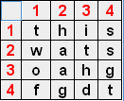
question2. Word puzzle
a two dimensional array of letters, a list of words, to find the words in the puzzle
One way:
  For each word in the list
  Check each order triple (row, column, orientation)
Another way:
  For each quadruple (row, column, orientation, number of characters)
  Test whether the word indicated is in the word list

Slide 29
1.5 Performance analysis
Criteria
  (1) Does the program meet the original specifications of the task?
  (2) Does it work correctly?
  (3) Does the program contain documentation that shows how to use it and how it work?
  (4) Does the program effectively use functions to create logical units?
  (5) Is program's code readable?
more concrete criteria (space, running time)
  (6) Does the program effectively use primary and secondary storage?
  (7) Is program's running time acceptable for the task?
performance analysis
( complexity theory )
performance
performance measurement
( machine--dependence
running times )
Notes:
性能分析：
程序能否实现预定任务
2. 程序是否正确？
3. 程序是否包含使用文档(how to use it)和设计文档(how it works)？
4. 程序是否按照逻辑单元有效的设计函数？
5. 代码是否具有可读性？
其他：
6. 程序是否有效的使用了一级和二级存储（内存和外存）？
7. 程序是否能在可接受的时间内完成任务？

Slide 30
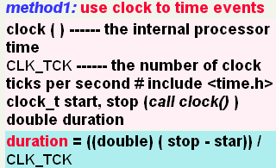
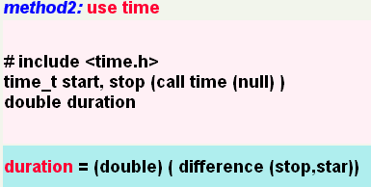
Performance measurement
★Generate a suitable large number of random test data
★Measure average case times
Notes:
性能度量
设计大量随机的测试例子
度量平均运行时间

Slide 31
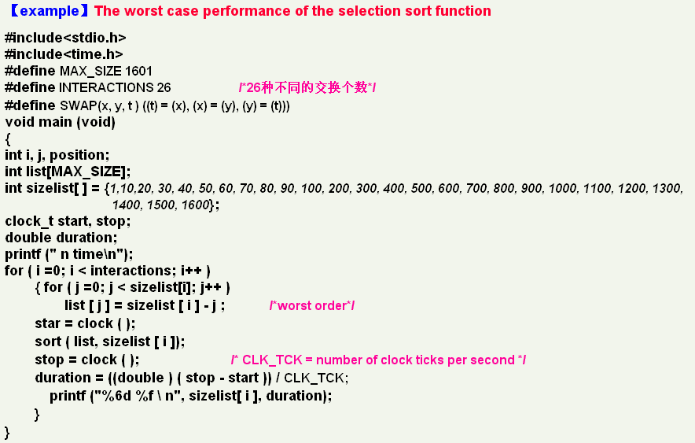
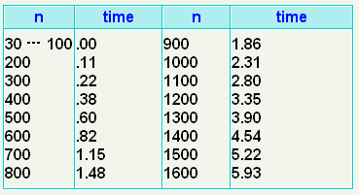
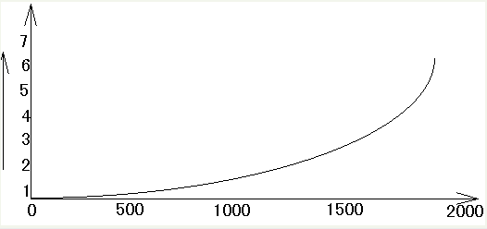

Slide 32
Complexity
【definition】
  The space complexity of a program is the amount of memory that it needs to run to completion.
  The time complexity of program is the amount of computer time that is need to run to completion.
Notes:
复杂度的概念：
空间复杂度：程序运行所需要使用的内存数量
时间复杂度：程序运行过程中所需要的时间

Slide 33
Space complexity
Fixed space requirements (C):
  instruction space (store the code)
  simple variables
  Fixed size structured variables
  constants
Variable space requirements:
  Sp( I ) , the space needed by structured variables whose size depends on the particular instance, I , of the problem being solved. ( +recursive space)
  I ---- number、size、value of the input and output.
S(P) = C + Sp( I )
Notes:
空间复杂度：
固定空间：包括指令空间（保存代码）、简单变量、固定大小的结构变量、常量等。
可变空间：取决于特定实例的一些结构变量所需的空间。

Slide 34
Space complexity computing - 1
float abc(float a, float b, float c)
{
return a+b+b*c+(a+b-c)/(a+b)+4.00)
}
S_{abc}( I )=0
float sum(float list[ ] , int n)
{
float tempsum=0;
int i;
for ( i=0; i < n; i++)
tempsum +=list[ i ];
return tempsum;
}
s_{sum}( I )= s_{sum}( n )
s_{sum}( n )=0
(C does not copy the array)
Notes:
空间复杂度的计算

Slide 35
Space complexity computing - 2
float rsum(float list[ ], int n)
{
if (n) return rsum( list, n-1) + list[ n-1 ];
return 0;
}
Type | Name | Number of bytes
parameter: float * parameter: integer return addresss:(used internally) | list [ ] n | 4 4 4 (unless a far address)
TOTAL per recursive call |  | 12
s_{rsum}( MAX_SIZE )= 12 * MAX_SIZE (n=MAX_SIZE )

Slide 36
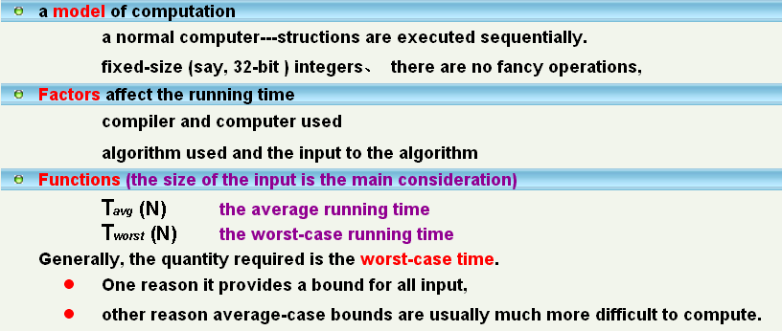
Time complexity
T(p)
  The sum of a program, p, compile time and run (or execution) time
  Example: T_{p}(n) = C_{a}ADD(n) + C_{s}SUB(n) + C_{l}LDA(n) + C_{ST}STA(n)
Notes:
时间复杂度

Slide 37
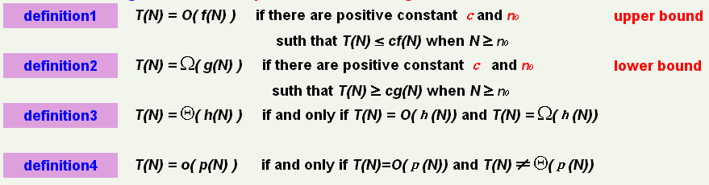
Mathematical Background
compare relation rates of growth for functions
Notes:
数学背景：

Slide 38
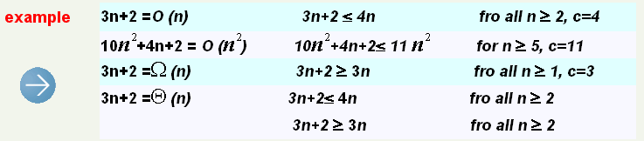
Given T(N)=1000N, F(N)=N²
We have T(N)=O(F(N))
F(N)=N²
f(N)
T(N)=1000N
1000
N

Slide 39
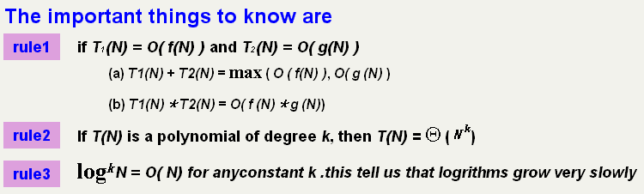
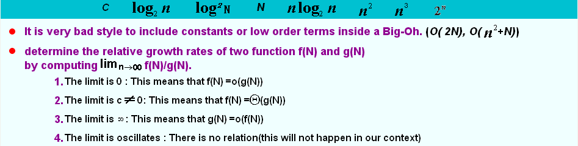

Slide 40
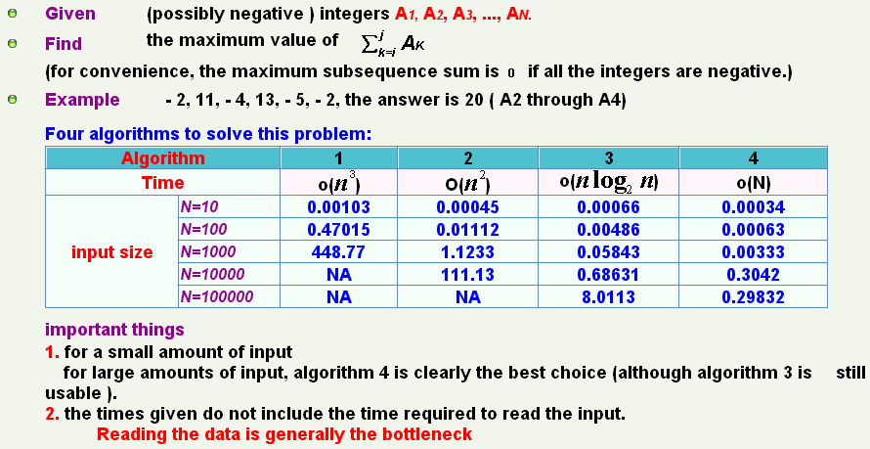
Maximum subsequence sum problem

Slide 41
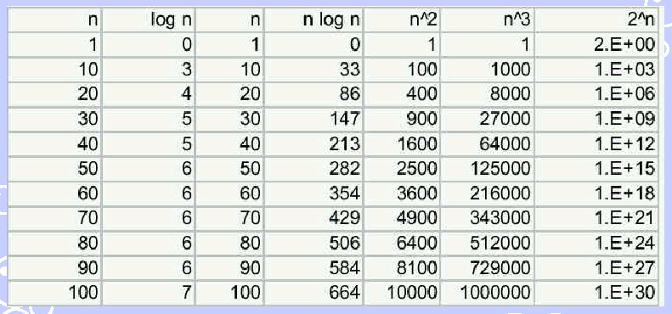
O(1), O(logn), O(n), O(nlogn), O(n²), O(n³), O(2^{n})…

Slide 42
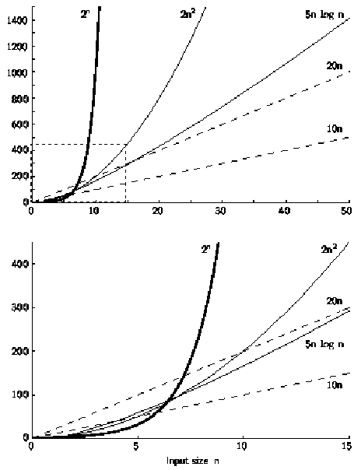
增长曲线

Slide 43
Running Time Calculations
【definition 】A program step is a syntactically or semantically meaningful program segment whose execution time is independent of the instance characteristics.
best way to decide which is faster is to code them both up and run them.
  Pinpoint the bottlenecks, which are worth coding carefully.
  Simplify the analysis, no particular units of time.
  Throw away leading constants. Throw away low-order terms, computing big-oh running time.
  big-oh is an upper bound guarantee that the program will terminate within a certain time period.
一个程序步，是语义上的程序片段，它的执行时间与实例的特性无关。

Slide 44
Program step computing - 1
Iterative summing of a list of numbers
float sum(float list[ ] , int n)
{
float tempsum=0; count++; /* for assignment*/
int i;
for ( i=0; i < n; i++) {
count ++; / * for the for loop */
tempsum +=list[ i ];
count ++; / * for assignment */
}
count ++; /* last execution of for*/
count ++; /* for return*/
return tempsum;
}

Slide 45
Program step computing - 2
float sum(float list[ ] , int n) /*simplified version*/
{
float tempsum=0;
int i;
for ( i=0; i < n; i++)
count += 2;
count += 3;
return 0;
}
count = 2n + 3
Statement | s/e Frequency Total steps
float sum(float list[],int n) { float tempsum=0; int i; for ( i=0; i < n; i++) tempsum +=list[ i ]; return tempsum; } | 0 0 0 0 0 0 1 1 1 0 0 0 1 n+1 n+1 1 n n 1 1 1 0 0 0
Total | 2n+3

Slide 46
Program step computing - 3
Recursive summing of a list of numbers
float rsum(float list[ ], int n)
{
count ++; /*for if conditional*/
if (n) {
count++; /* for return and rsum invocation */
return rsum( list, n-1) + list[ n-1 ];
}
count++;
returm list [ 0 ];
}
Statement | s/e Frequency Total steps
float rsum(float list[ ], int n) { if (n) return rsum( list, n-1) + list[ n-1 ]; return list [ 0 ]; } | 0 0 0 0 0 0 1 n+1 n+1 1 n n 1 1 1 0 0 0
Total | 2n+2

Slide 47
Program step computing - 4
Matrix addition
void add(int a[MAX_SIZE], int b[MAX_SIZE], int c[MAX_SIZE],
int rows, int cols)
{
int i , j;
for ( i =0; i < rows; i++)
for ( j = 0; j < cols; j++)
c[ i ][ j ] = a [i ][ j ] +b [i ][ j ];
}
Statement | s/e Frequency Total steps
void add(int a [ MAX_SIZE ] … { int i , j; for ( i =0; i < rows; i++) for ( j = 0; j < cols; j++) c[i][j] = a[i][j] + b[i][j]; } | 0 0 0 0 0 0 1 rows+1 rows+1 1 rows(cols+1) rows*cols+rows 1 rows*cols rows*cols 0 0 0
total | 2*rows*cols+2rows+1

Slide 48
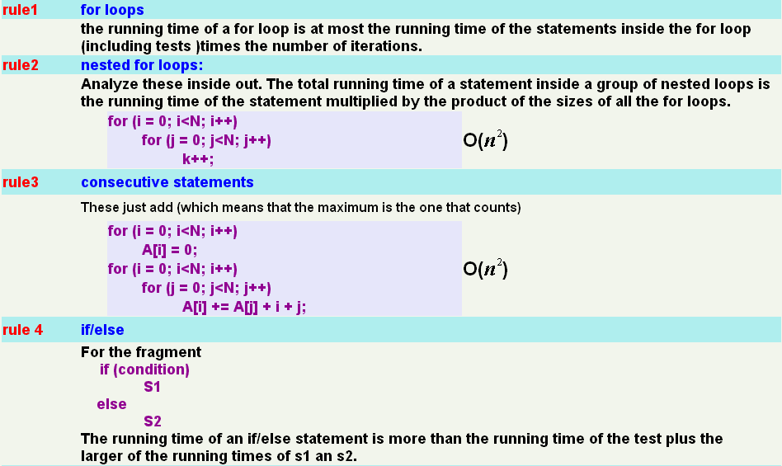
Running Time Calculations Rule

Slide 49
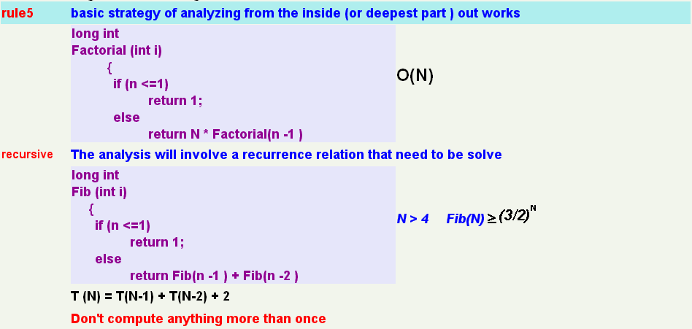
Running Time Calculations Rule

Slide 50



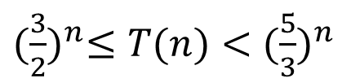
Running Time Calculations Rule
long int Fib( int n)
{
if(n<=1)
return 1;
else
return Fib(n-1)+Fib(n-2);
}

Slide 51
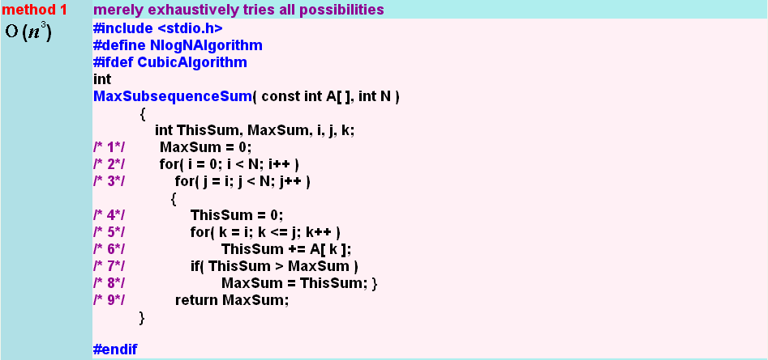
Maximum subsequence sum problem

Slide 52
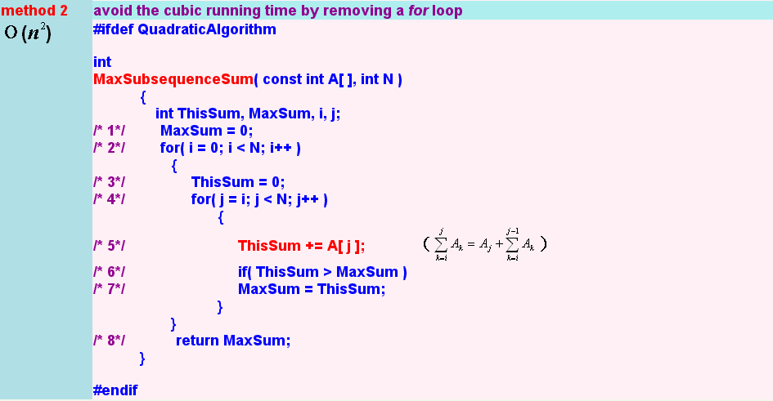
Maximum subsequence sum problem

Slide 53
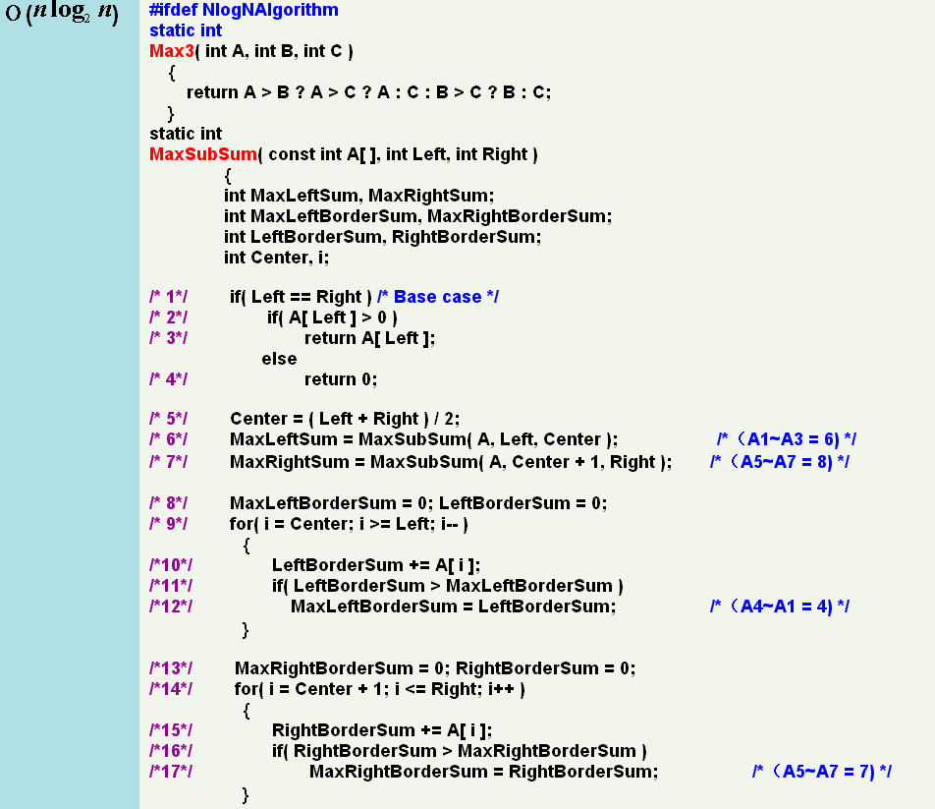
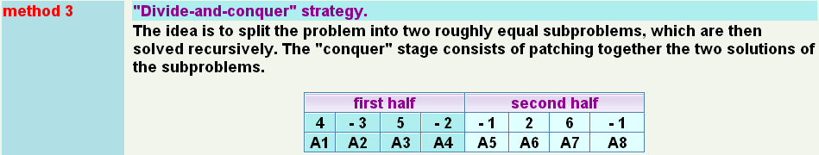
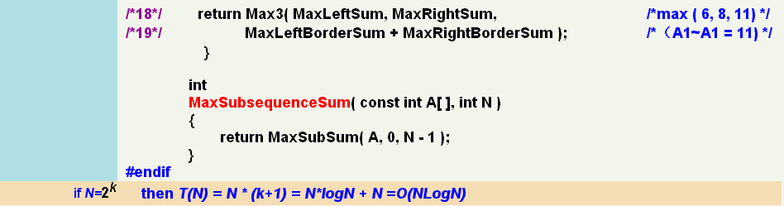

Slide 54
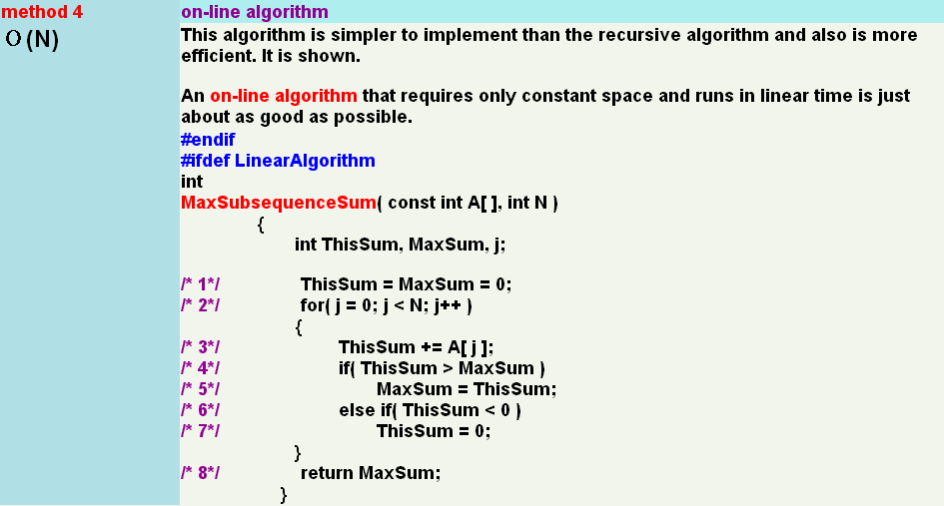
Maximum subsequence sum problem

Slide 55
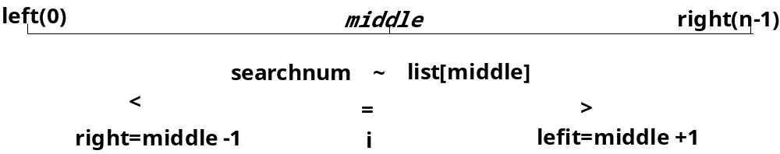
Logarithms in Running Time Example Binary search-1
given:
  a sorted list : list [ n ]
  search number : searchnum
return:
  i if list [ i ] = serachnum
  -1 if not present in the list
An algorithm is O( log N) if it takes constant (O(1)) time to cut the problem size by a fraction (which is usually 1/2)
Algorithm:
  while ( there are more integers to check ) {
  middle = (left +right )/2;
  if ( serchnum < list[middle] )
  right = middle - 1;
  else if ( serchnum == list[middle])
  return middle;
  else left = middle + 1;
  }

Slide 56
Logarithms in Running Time Example Binary search-2
Algorithm:
  for comparing:
  1. macro version
  #define compare(x,y) ((x) < (y)? -1:((x) == (y)) ? 0:1)
  2. function version
  int compare ( int x, int y )
  {
  /* compare x and y, return -1 for less than, 0 for equal,
  1 for greater*/
  if ( x < y ) return -1;
  else if ( x == y ) return 0;
  else return 1;
  }

Slide 57
Logarithms in Running Time Example Binary search-3
Program:
int binsearch ( int list [ ], int searchnum , int left, int right )
{ /* search list [ 0 ] <= list [ 1 ] <= ··· <= list [ n-1 ] for searchnum.
Return its position if found . Otherwise return -1*/
int middle ;
while ( left <= right ) {
middle = ( left + right ) / 2;
switch ( COMPARE ( list [ middle ] , searchnum )) {
case -1 : left = middle + 1 ;
break;
case 0 : return middle;
case 1 : right = middle - 1;
}
}
return -1;
}

Slide 58
Logarithms in Running Time Example Binary search-4
如何写一个递归函数：
  建立边界条件，用来中断递归调用。
  递归调用每一步都要接近于结果。
Binary Search Program:
int binsearch(int list[], int searchnum, int left, int right)
{
int middle;
if (left <= right){
middle = (left + right) / 2;
switch ( COMPARE(list[middle], searchnum)) {
case –1: return binsearch(list, searchnum,middle + 1, right);
case 0: return middle;
case 1: return binsearch(list, searchnum, left, middle – 1);
}
}
return –1;
}
边界条件：
1）找到，则返回找到的数（middle）
2）找不到，则 left > right

Slide 59
Homework
Page 17 2, 8, 11
Page 21 2
Page 25 2
Page 32 1
Page 41 6

